Slide 1
TOPIC 7:
CONTROL SYSTEMS
LESSON 7-2
INPUT & OUTPUT IN CONTROL SYSTEMS

Slide 2
AGENDA
Sensor Types
Output Transducer
Feedback
NOTE!
Have a way to take notes available for this lesson

Slide 3
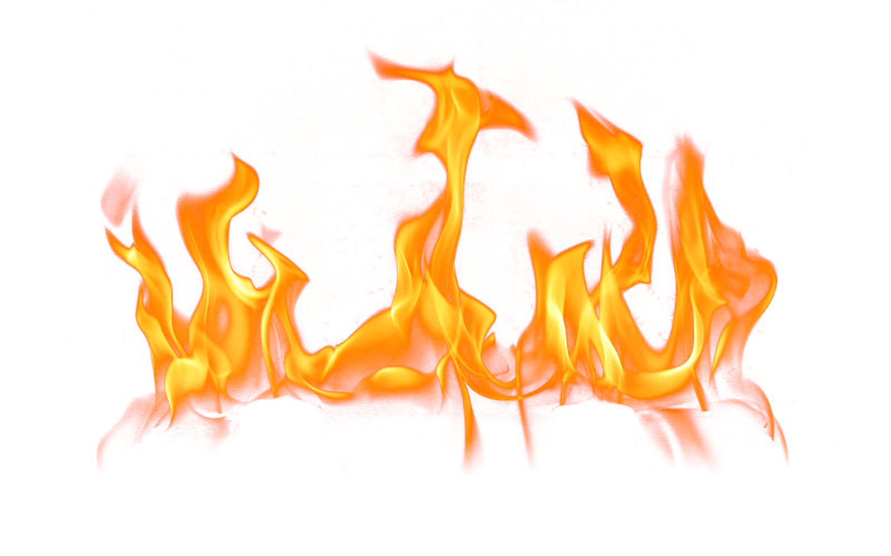
THE WARM UP QUESTION
Explain how GPS works.

Slide 4
THE WARM UP ANSWER
Award [4 max]
The GPS receiver in a train takes the information from the satellite/ picks up the signals from (at least) 3 satellites;
The signals transmitted are: time of transmission, coordinates of the satellite;
The difference between the (atomic) time of transmission and (atomic) time of receiving the signal is used to calculate the distance;
The method of trilateration is used to determine position from the distance to satellites/ is used to determine the train’s exact position/ is used to calculate position of the train through equation resolution on a sphere;

Slide 5
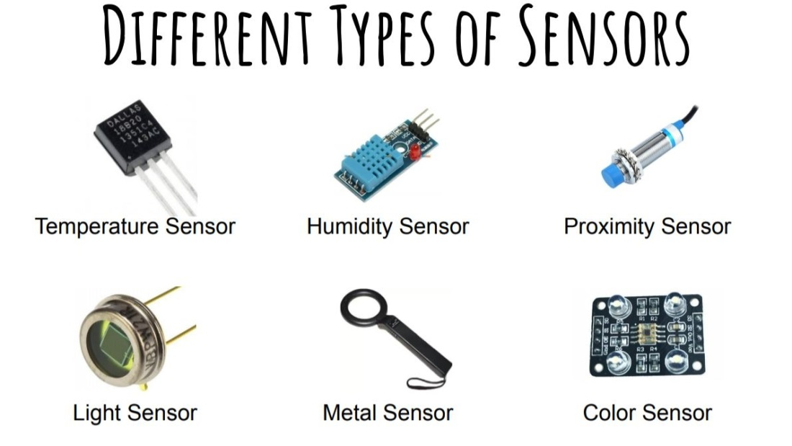
SENSORS
Sensors – sense a physical property then transform it into an electrical signal
We previously discussed sensors in control systems that serve as input devices
There are a large number of sensor types, and we continue to invent more

Slide 6
CONTROL SYSTEMS
Control System Example:
We’ll be looking at some examples of control systems in today’s lesson
Strap in, and be thinking about other types of control systems you might encounter

Slide 7
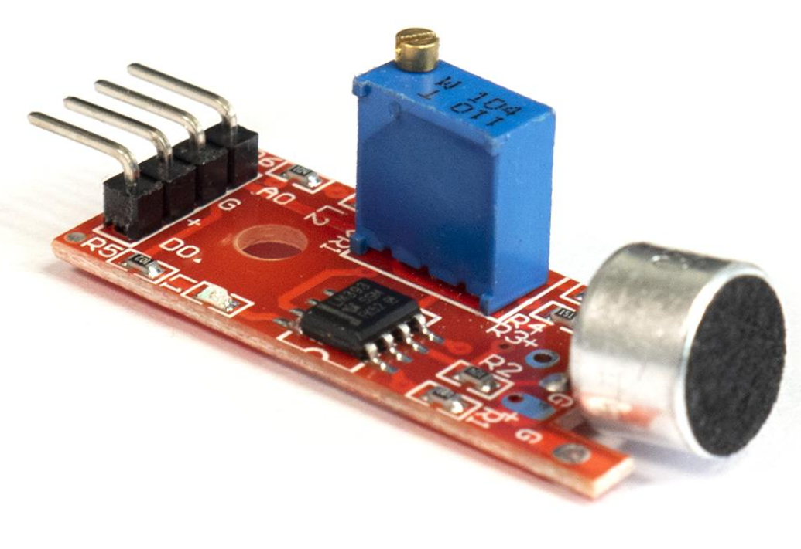
SOUND SENSORS
Sound sensors – detect sound waves
Used widely in microphones

Slide 8
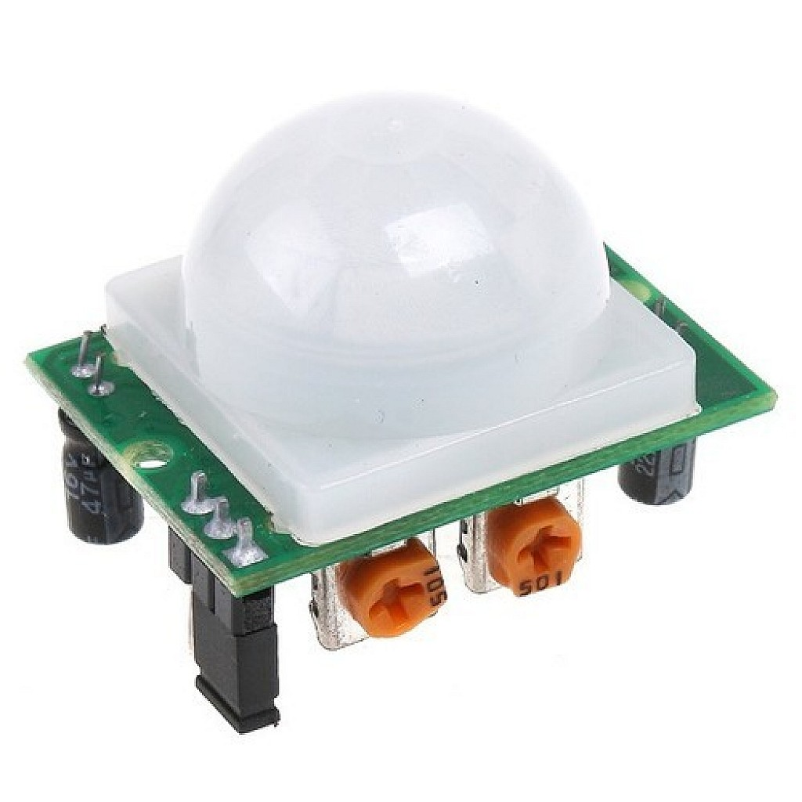
MOTION SENSORS
Motion sensors – detect moving objects
Used in security/alarm systems
Used in automated lighting (like here at Alcuin) to conserve energy

Slide 9
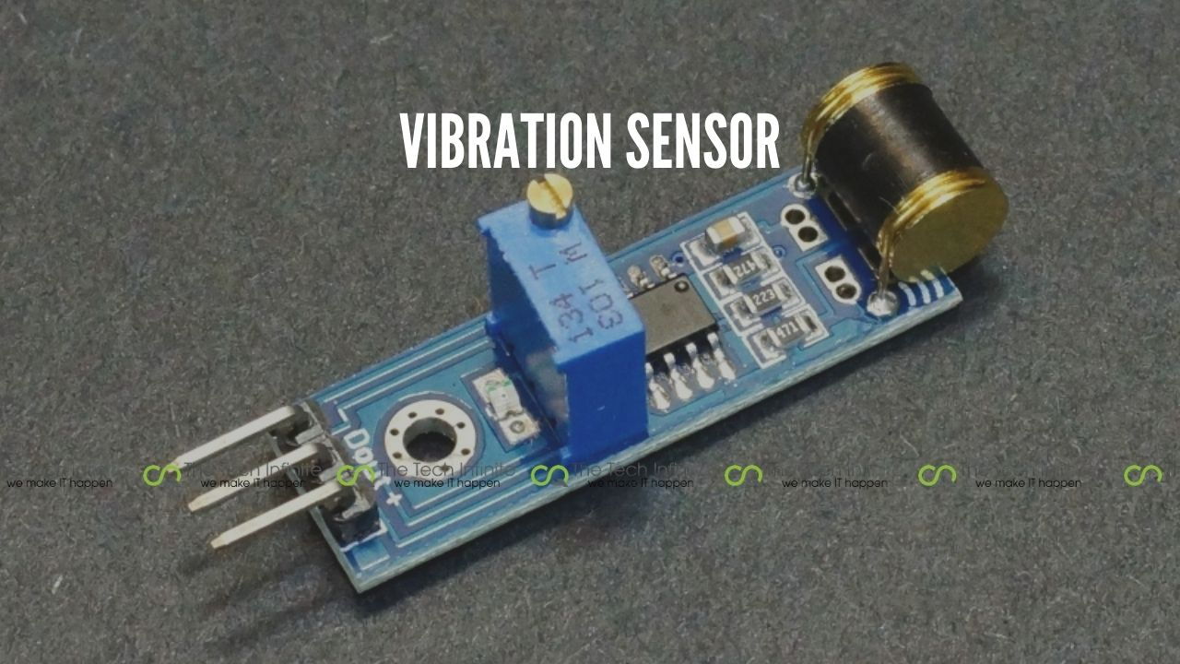
VIBRATION SENSORS
Vibration sensors – detect vibrations – placed on surfaces that can vibrate
Used in security/alarm systems
Used in acoustic musical instruments (instead of microphones)

Slide 10
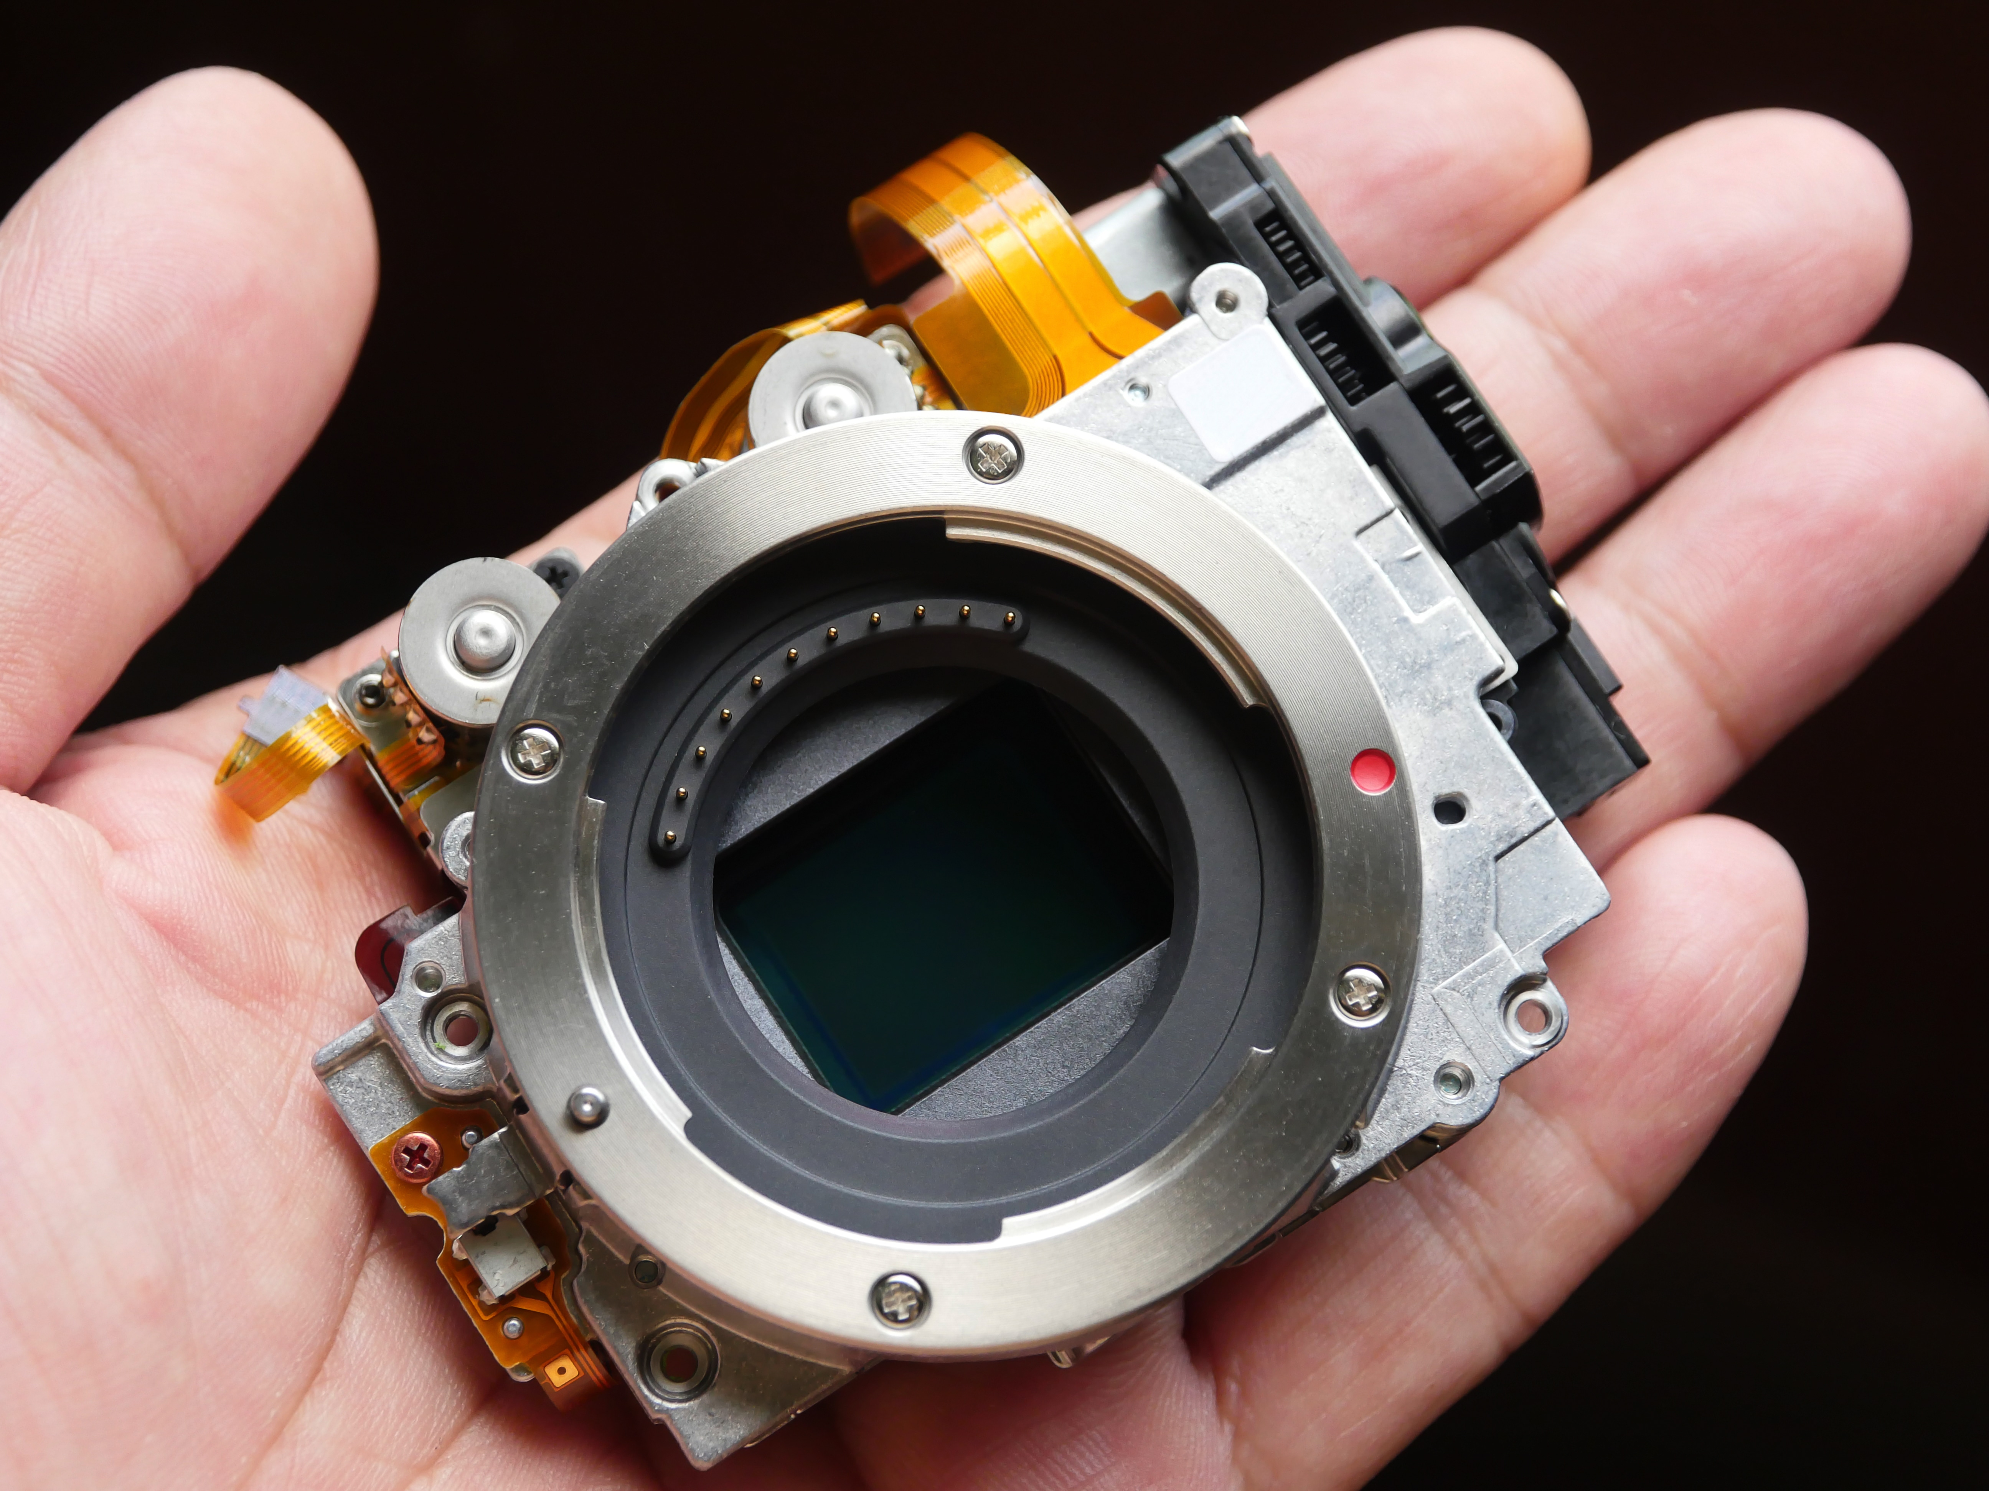
OPTICAL/IMAGE SENSORS
Optical/Image Sensors – two kinds exist
Active Pixel Sensor (APS) – used in digital camera
Contain an array of pixel sensors that can imprint light
Infrared (IR) – used to sense infrared light, typically invisible.
Used in security/alarm systems to detect motion at night
Used in night-vision cameras

Slide 11
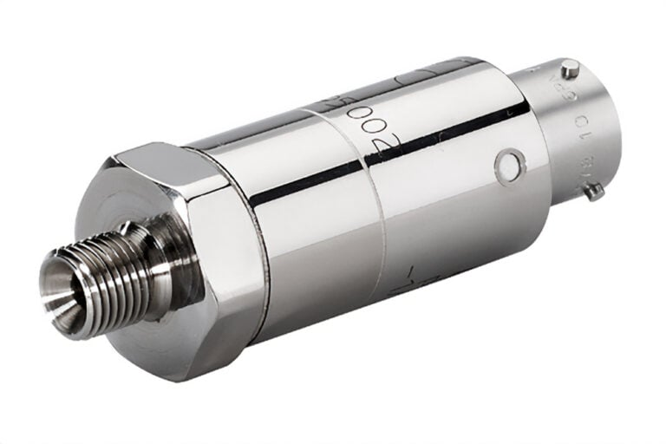
PRESSURE SENSORS
Pressure Sensors – detect pressure
Used in touch-screen devices
Used in cars to detect how far down a pedal is pressed

Slide 12
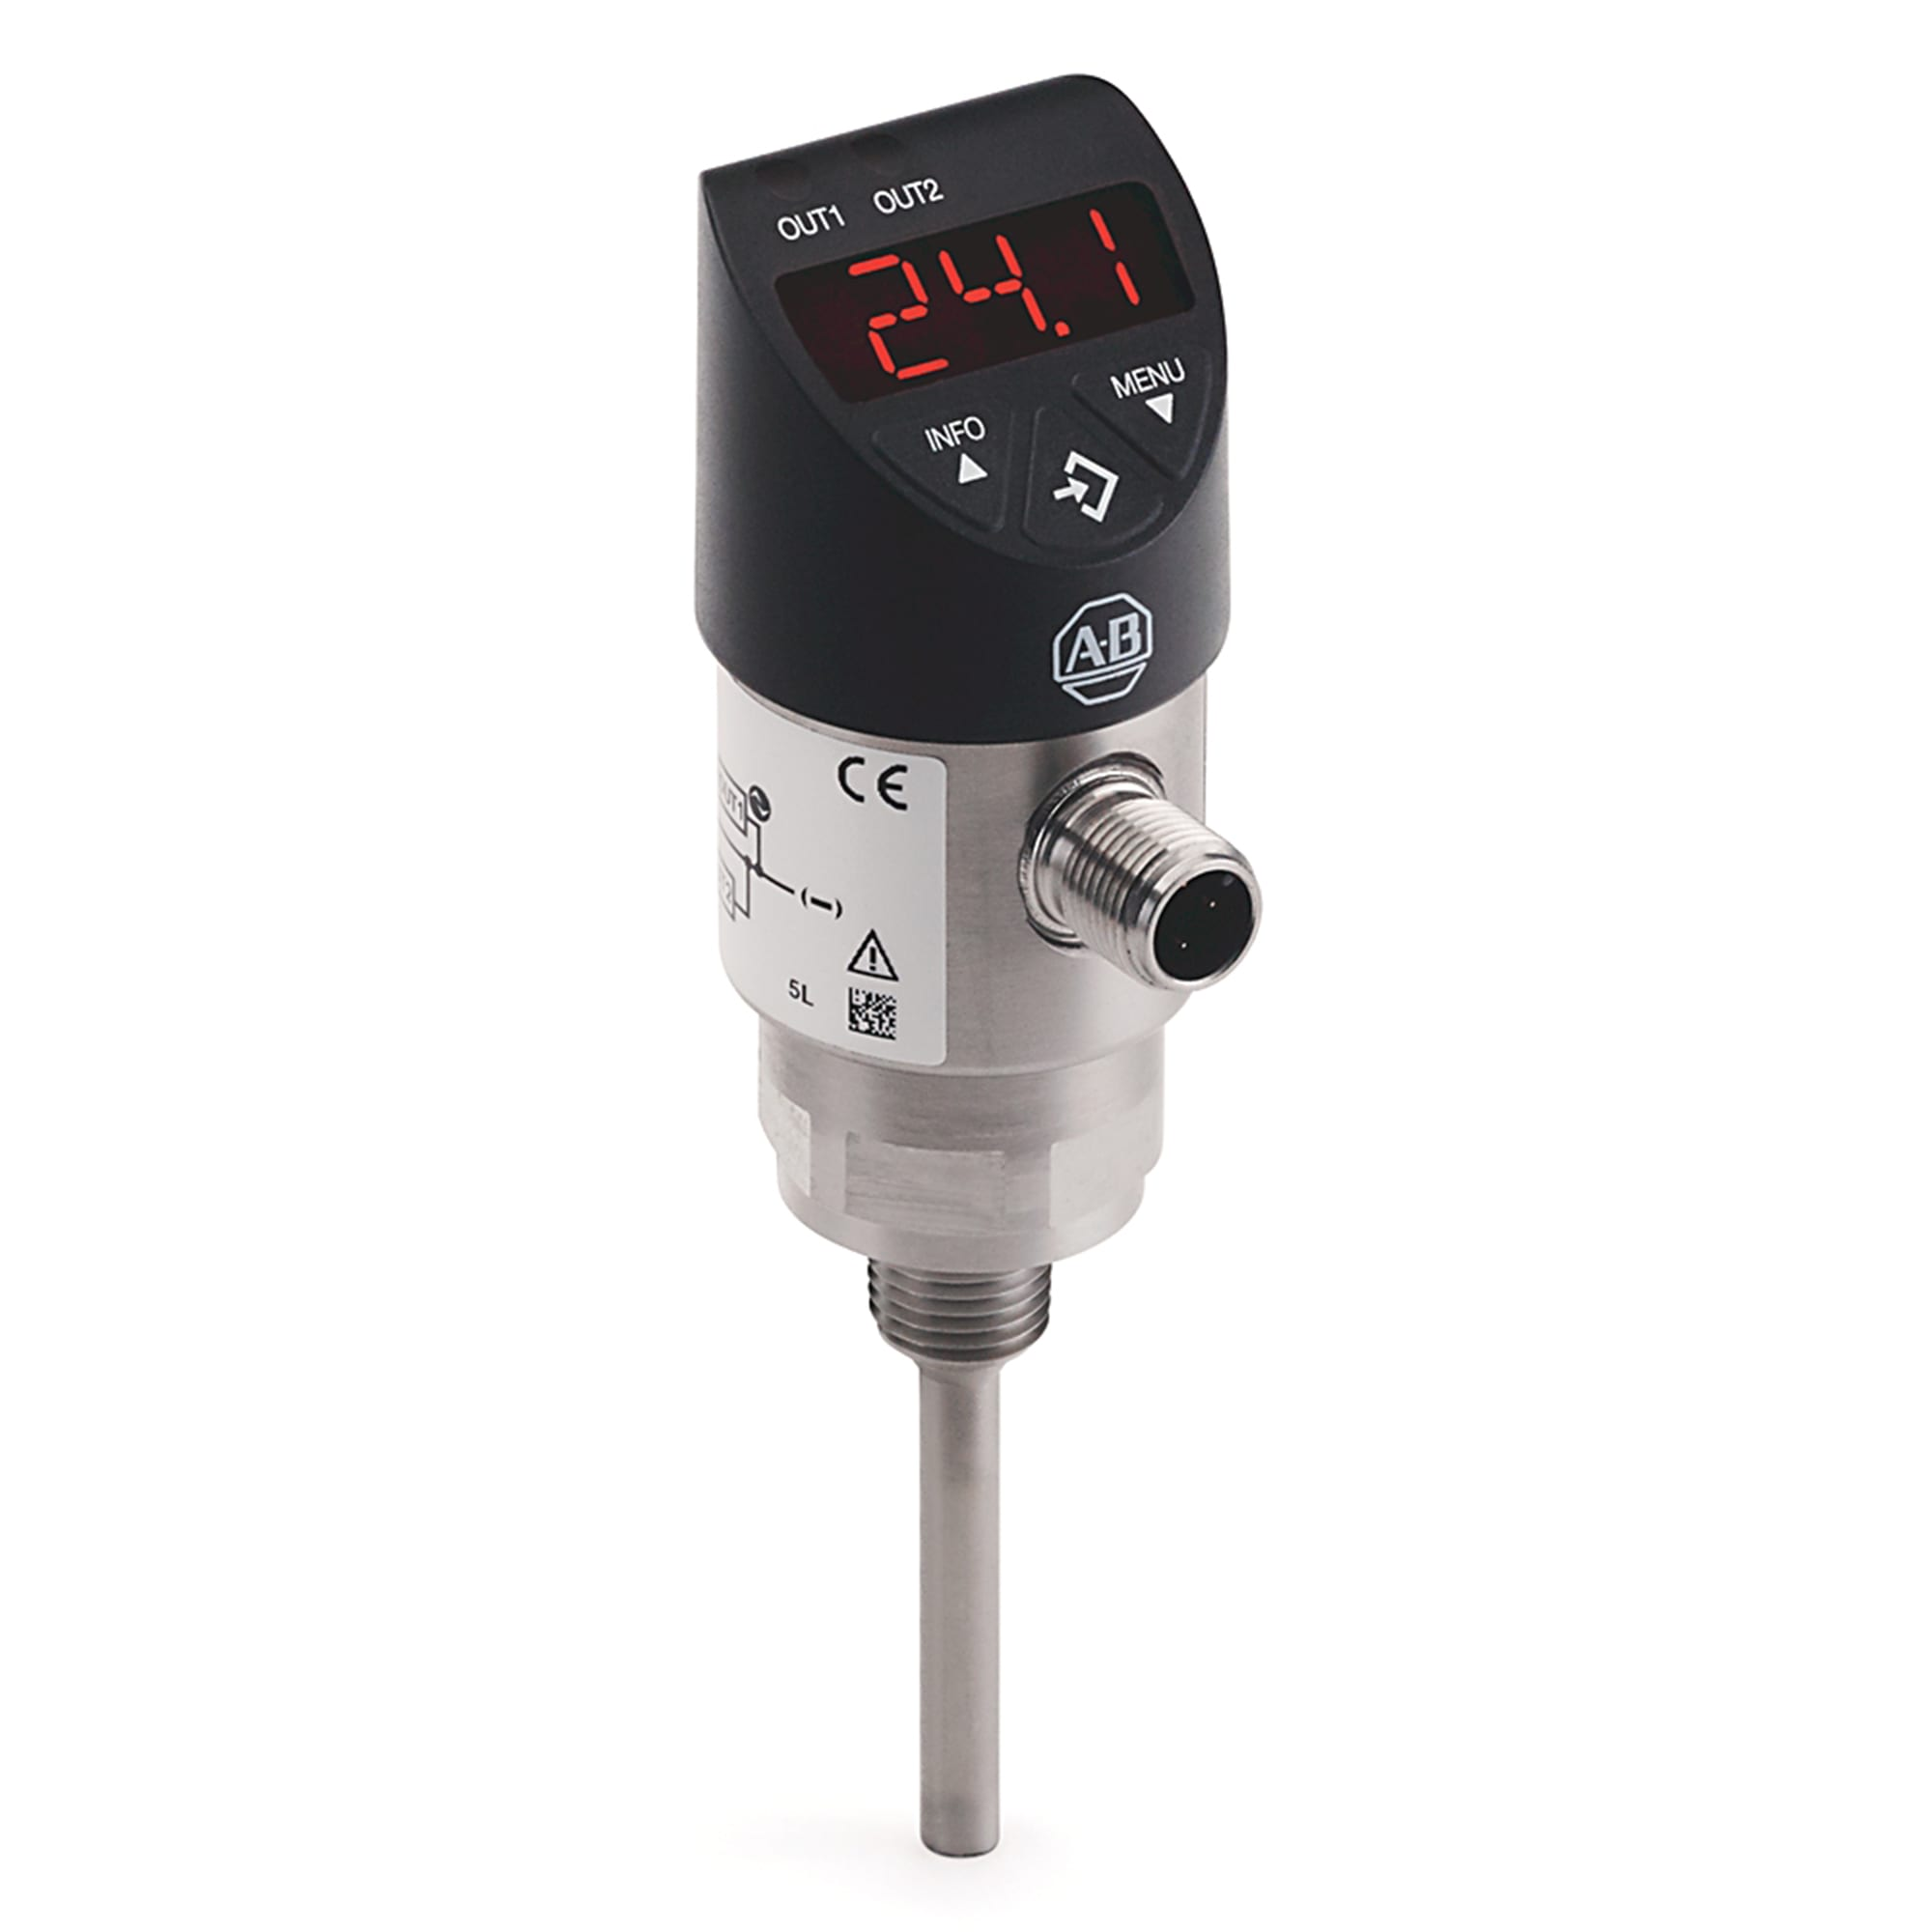
TEMPERATURE SENSORS
Temperature Sensors – detect temperature
Widely used in thermostats to control temperature settings

Slide 13
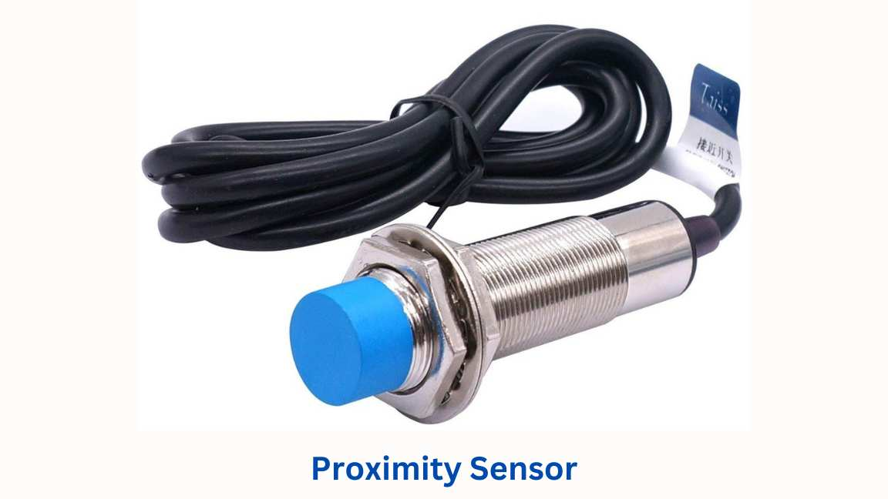
PROXIMITY SENSORS
Proximity Sensors – detect presence of nearby objects without any physical contact
Used in cars to detect if cars are in your blindspot or how close you are to a wall

Slide 14
SENSOR DATA
Is temperature an analog or digital value?

Slide 15
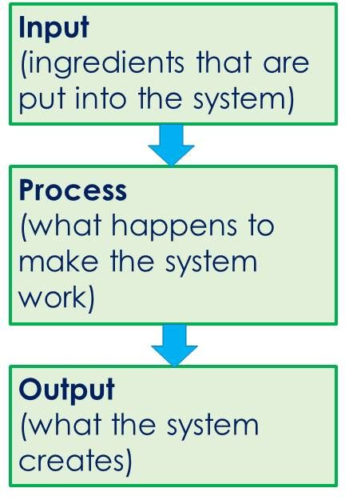
SENSOR DATA
Because a temperature sensor is taking an analog value, it will need to convert it to a digital value
Use an analog to digital converter (ADC)
This input can then be read by processors
The input is processed and output is delivered
Recall the input -> process -> output pipeline that every algorithm has

Slide 16
TRANSDUCERS
Transducers convert physical quantities (speed, temperature, humidity, pressure, etc.) into electrical singlas
This conversion from one type of energy to another is called transduction
ALL sensors are categorized as transducers
But, sensors only do the input side of things

Slide 17
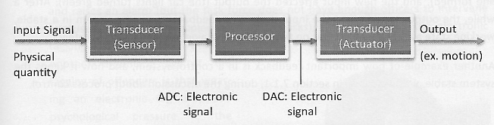
TRANSDUCERS
The other type of transducer is the actuator
Actuators are responsible for moving some kind of mechanism
They typically receive energy and convert it into motion
RECAP:
Sensors get input, send it to a microprocessor for processing, and convert that signal to motion using an actuator
Both actuators and sensors are transducers

Slide 18
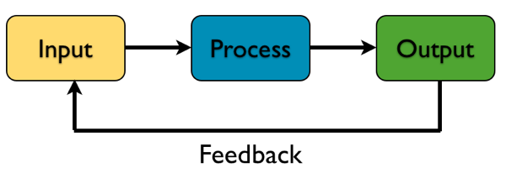
FEEDBACK SYSTEMS
Some systems are designed to have feedback
In a feedback system, the result of an output is used as part of the new input to the control system to determine the best course of action for the next output
Example: traffic lights that use sensors to detect how many cars are there to decide how to change lights
The number of cars there depends on the previous output of the lights, in part, but also on how much other traffic there is

Slide 19
SHORT WORKSHEET
Pull up the WS 7-1, it’s a short worksheet where you map out a system.

Slide 20
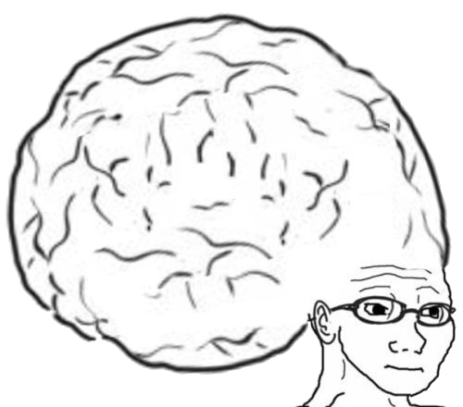
VOCAB TO REMEMBER
Actuator
Microprocessor
Sensor

